Slide 1
Are Your V8 GC Logs Speaking to You?

Slide 2
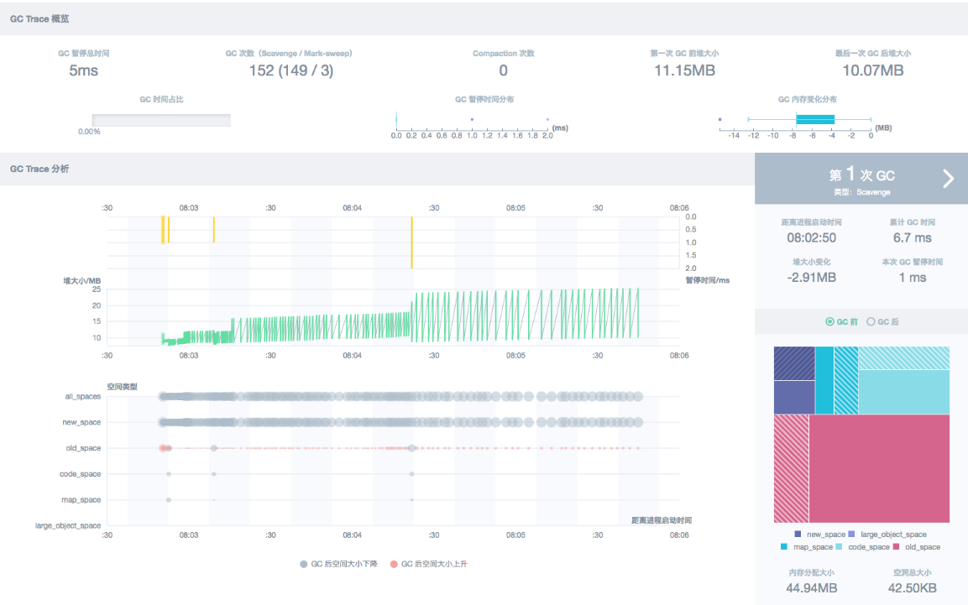
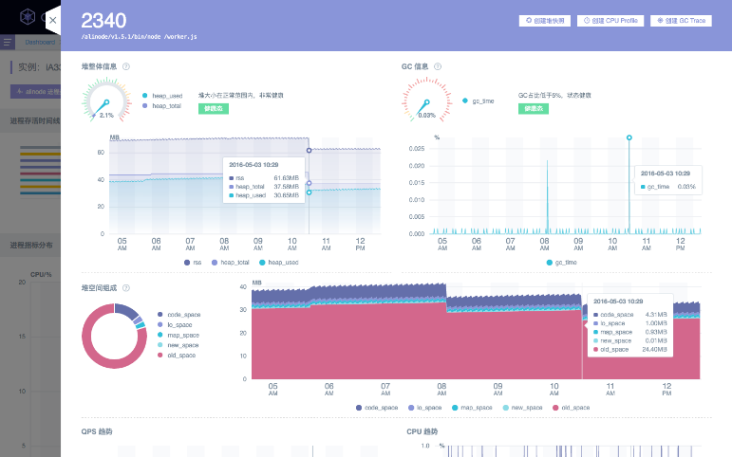

About Me
@joyeecheung (GitHub, Twitter)
Chau Yee Cheung (Cantonese) Qiuyi Zhang /张秋怡 (Mandarin)
Joyee
Intern @ alinode ∈ AliCloud ∈ Alibaba Group

Slide 3
Background
We provide performance management services for teams both inside and outside the group
Alibaba is one of the largest company in China that uses Node.js in production
Backed by services written in Java
Tmall, Alipay, Taobao...
Mostly driven by frontend devs
Building new products and refactoring old products(PHP/Java)

Slide 4
Background
Java architects argue that Node.js is not mature enough
Lack of tooling for monitoring and profiling
Also argued by people leaving Node.js for Go
Java programmers know their VM and their GC. As for JS programmers, well…
Most come from a frontend dev background
CPU profile: the pursuit of 60fps
Heapdump: you don't want to blow up your users' RAM
GC logs: ???

Slide 5
What are V8 Garbage Collection logs good for?
Combined with heap profiles, they can help you catch the culprit for memory leaks
Long GC pauses, GC thrashing
Can give you a bigger picture about what's going on so you know where to start
Help you verify that your fixes do fix your leaks
Least documented and least intuitive, not available in devtools

Slide 6
An introduction to V8 GC
What is Garbage Collection(GC)?
Collect and free your objects(garbage) when you don’t need them anymore
Dynamic languages usually have it, so you don’t have to manage the memory yourself
For ECMAScript/JavaScript, there are no specifications about it

Slide 7
An introduction to V8 GC
This talk is based on V8 4.5.103.35 (the one used by Node v4.x)
Generational hypothesis
Most objects die young, others tend to live forever
V8 GC Strategy
Generational: Young and Old
Conservertive: What’s in a block memory, pointer or data? We don’t know for sure!
In V8, Objects live on the heap, and the heap is divided into spaces

Slide 8
An introduction to V8 GC
New space
Divided in half, most objects start and end their lives here
Old space
Objects survive more than two GCs in the new space
Large object space
Objects too large to fit in other spaces
Never moved by GC
Map space
Hidden classes, pointed by objects
Code space
Executable code compiled by V8
FYI: for a long time V8 has only compilers, though it added an interpreter for lightweight devices last year

Slide 9
An introduction to V8 GC
GC is triggered by allocations(new or var most of the time), , when the memory allocated for a space is not enough
New space: Scavenger
Implementation of Cheney's algorithm
Active Semispace
Inactive Semispace
Allocation Pointer

Slide 10
An introduction to V8 GC
GC is triggered by allocations(new or var most of the time), , when the memory allocated for a space is not enough
New space: Scavenger
Implementation of Cheney's algorithm
Active Semispace
Inactive Semispace
Allocation Pointer

Slide 11
An introduction to V8 GC
GC is triggered by allocations(new or var most of the time), , when the memory allocated for a space is not enough
New space: Scavenger
Implementation of Cheney's algorithm
Active Semispace
Inactive Semispace
The active semispace is full now, start GC!
Allocation Pointer

Slide 12
An introduction to V8 GC
GC is triggered by allocations(new or var most of the time), , when the memory allocated for a space is not enough
New space: Scavenger
Implementation of Cheney's algorithm
Inactive Semispace
Active Semispace
Switch the role of the two spaces, copy all the live objects to the new semispace
Allocation Pointer

Slide 13
An introduction to V8 GC
Scavenger is cheap in terms of time, expensive in terms of space(doubled)
For long-lived objects, it’s a waste of memory
Objects surviving more than two GCs in the new space will be promoted to the old space

Slide 14
An introduction to V8 GC
Old space: mark-sweep/mark-compact
Marking: depth-first-search starting from the root object(window or global), mark all reachable objects with a bitmap(one per page)
Sweep/Compact to reclaim memory
Sweeping: iterates across the marking bitmap, looking for ranges of unmarked objects, put them into the free list
Kinda like the process of the scavenger GC
Compacting: since objects are arranged in pages, there will be fragmentation(holes). Moving objects from fragmented pages to free spaces on other pages can reduce the memory usage.

Slide 15
Getting started with V8 GC logs
Plenty of options(node --v8-options| grep gc)
We’ll be focusing on
--trace_gc
--trace_gc_nvp
Obviously you can't use these in production, even though it would be difficult to reproduce your problems offline
You can use signals to turn it on/off, and redirect them to a file
Or use alinode to get them by clicking a button on our SAAS platform, wink wink
In case you do want to read the code
deps/v8/src/heap, start with gc-tracer.cc

Slide 16
Demo Time

Slide 17
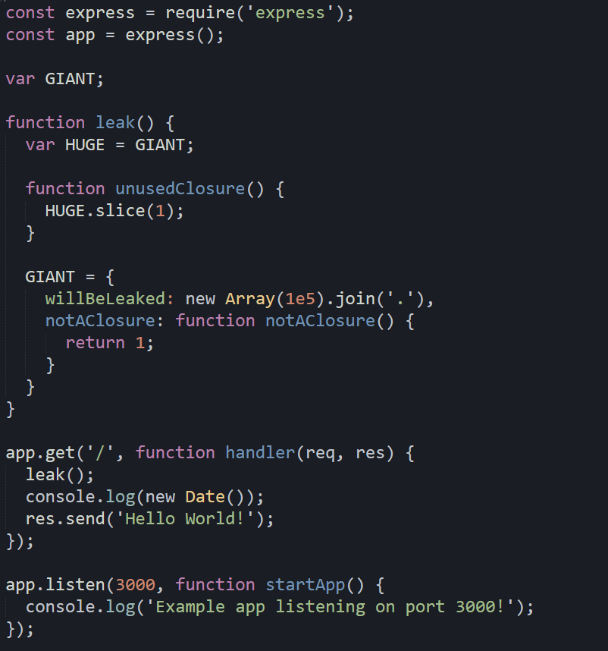
Leaks caused by closures
Closures are created when declared, not when executed
Any closure will be shared by all functions in the same context, even when the closure won’t be referenced at all

Slide 18
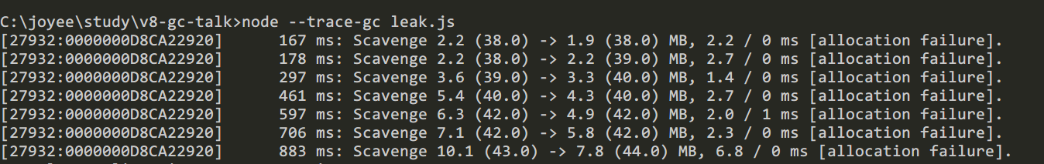
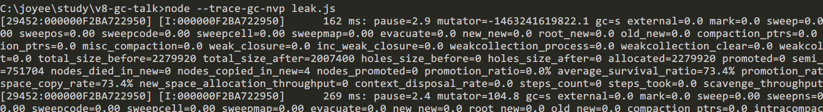
Leaks caused by closures

Slide 19
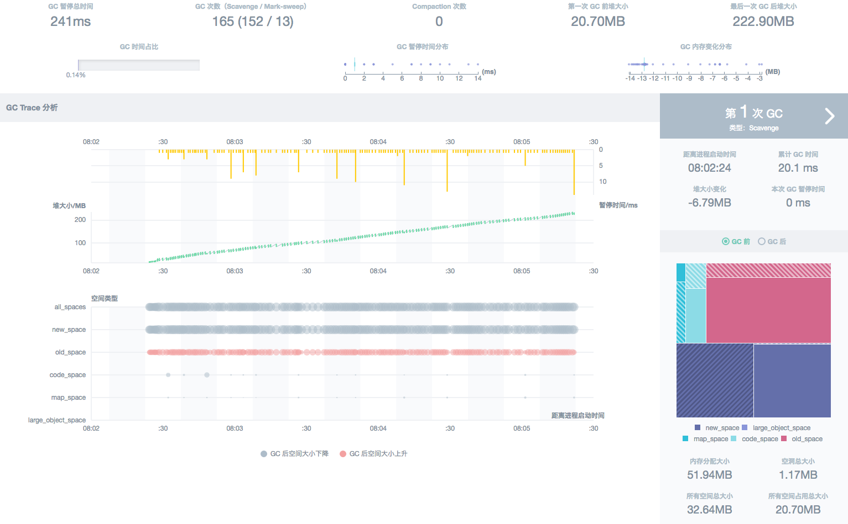
Leaks caused by closures

Slide 20
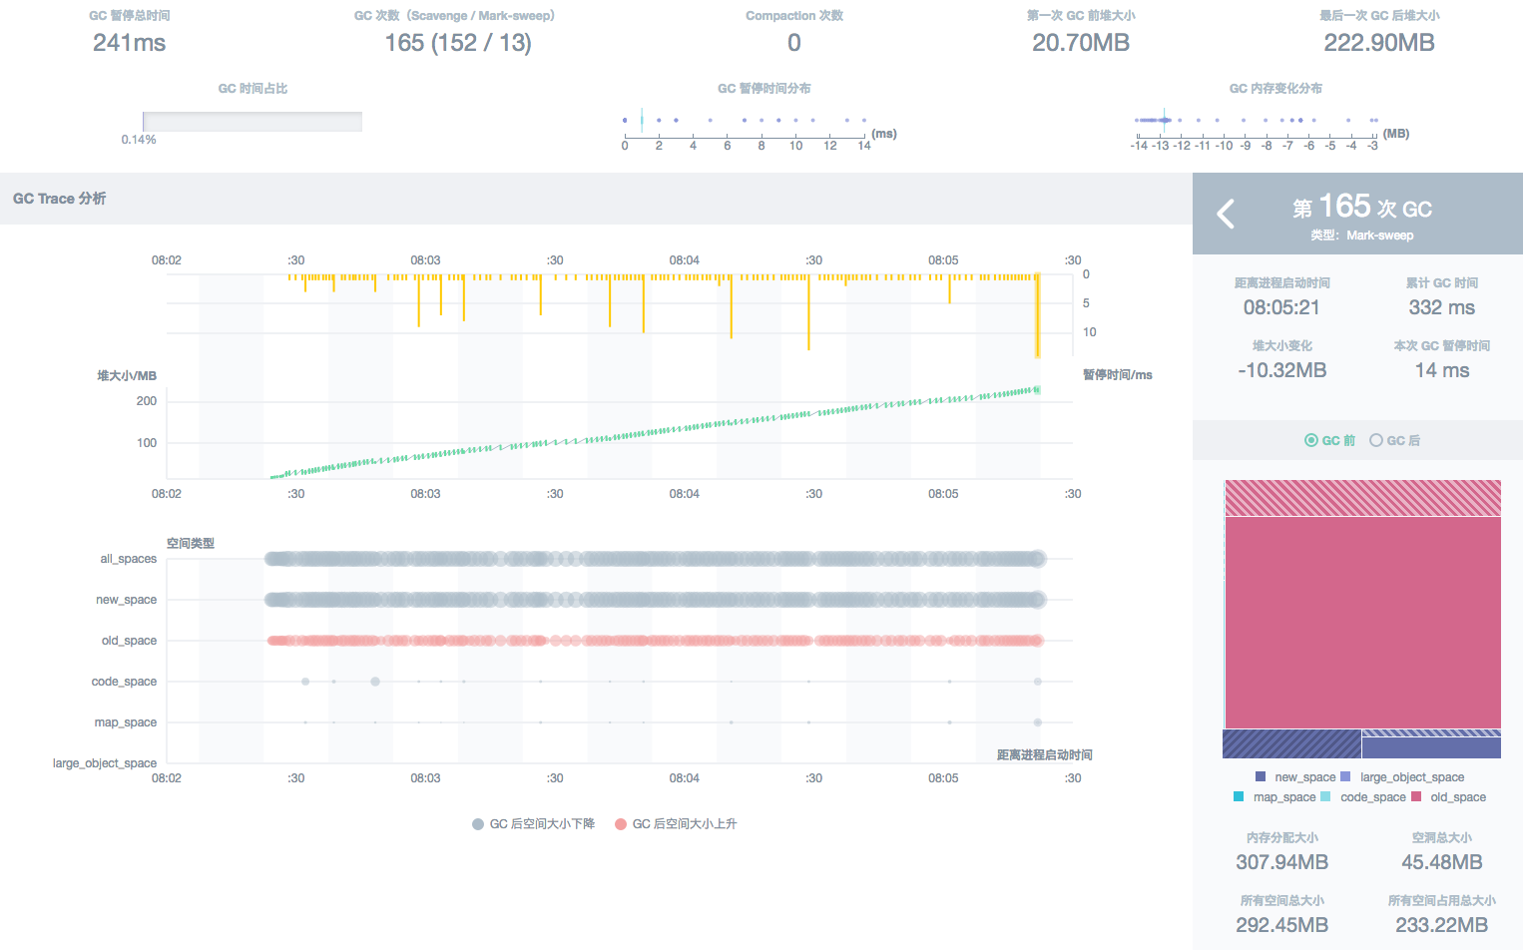
Leaks caused by closures

Slide 21
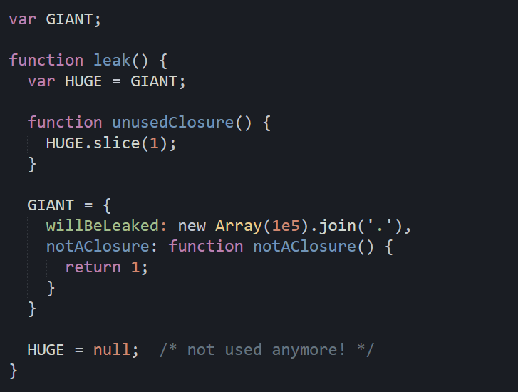
Solution #1: nullify your reference
Explicitly free the old object

Slide 22
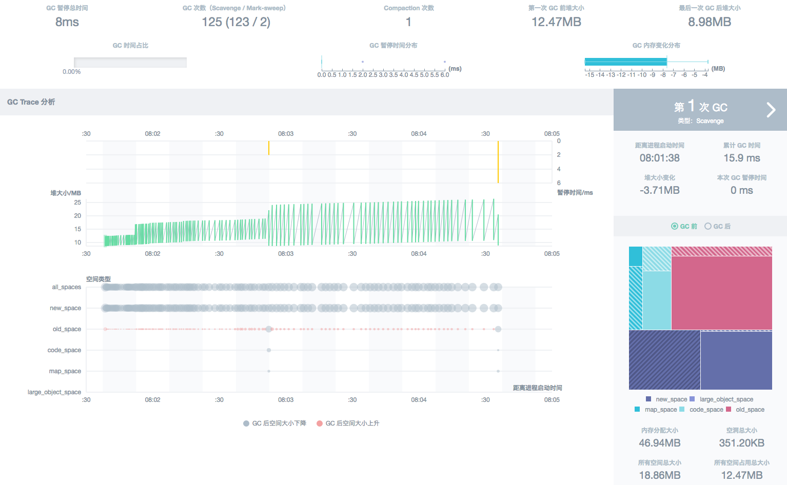
Solution #1: nullify your reference

Slide 23
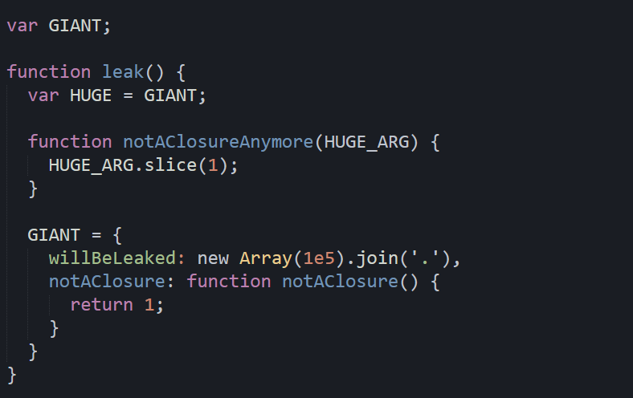
Solution #2: passing parameters
Avoid closures like a plauge

Slide 24

Solution #2: passing parameters

Slide 25
https://alinode.aliyun.com joyeec9h3@gmail.com @joyeecheung (GitHub, Twitter)
Questions?

